Slide 1
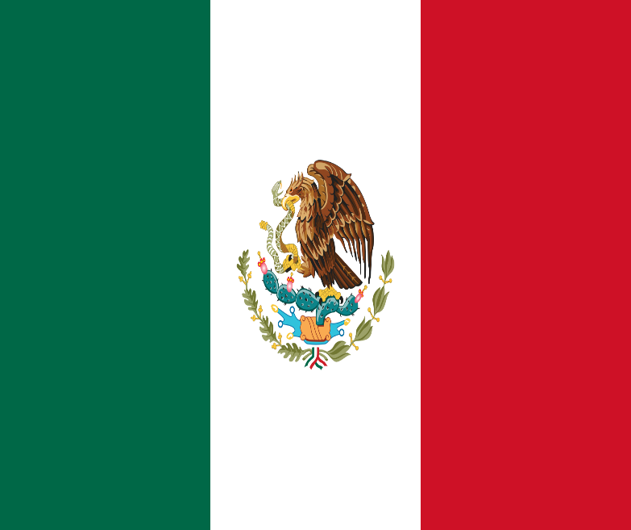
MEXICO CULTURAL SOCIETY ANALYSIS
The current president is Andrés Manuel López Obrador.

Slide 2
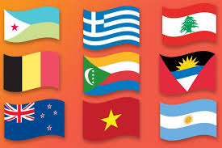
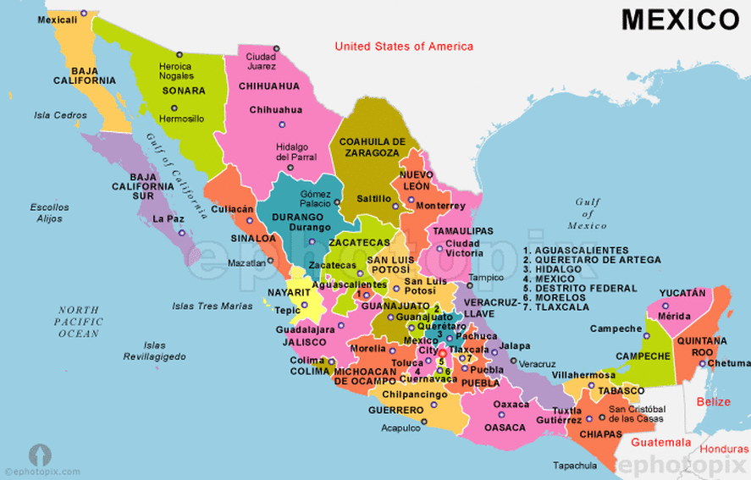
What makes Mexico?
Mexico is made up of 31 states and one federal district.

Slide 3
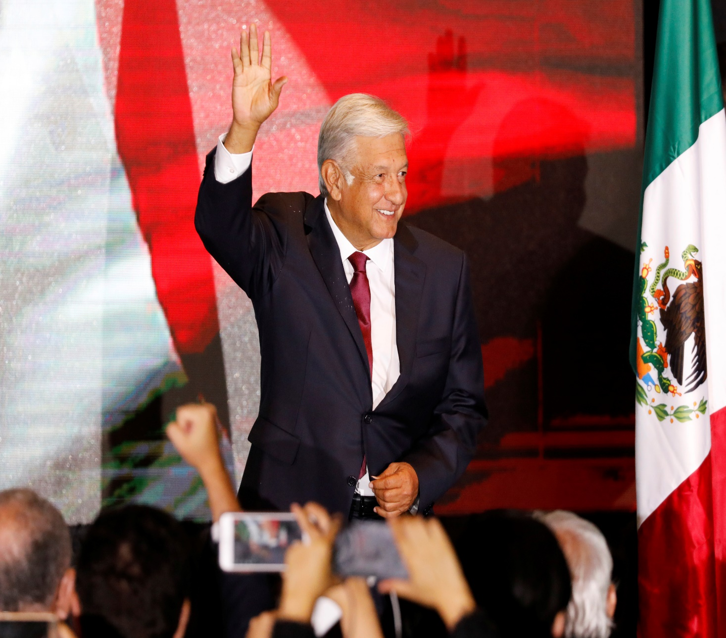
Presidential system
Form of government: Republic
The basic title: President
The president is the:
Head of State
Head of government
Head of a multi-party system

Slide 4
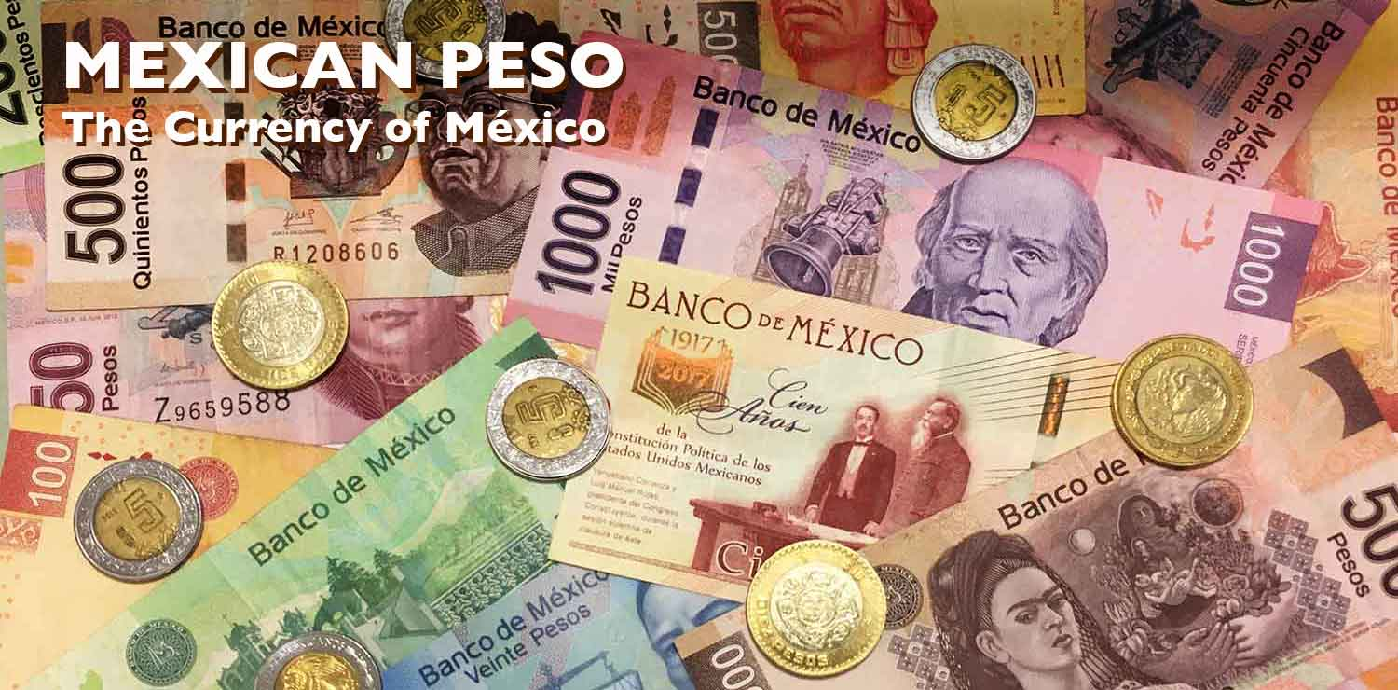
MONEY!
Peso is the Mexican currency.
The paper form of currency is presented in pesos of twenty, fifty, one, two and five hundred.
The coin pesos are in the form of one, two, five, ten and twenty denominations from twenty and (100 centavos=1 pesos) 50 centavos.

Slide 5
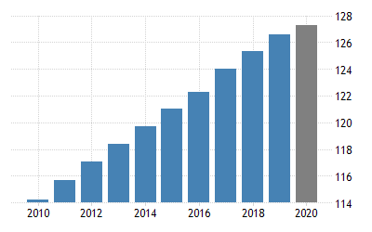
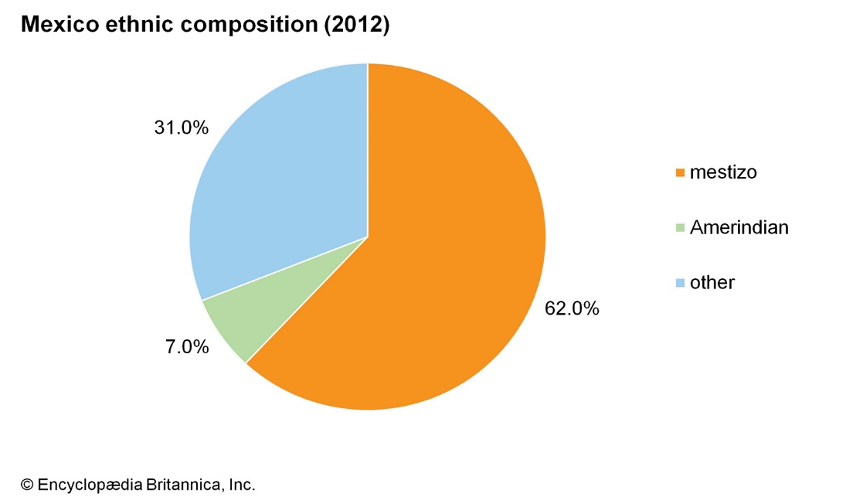
POPULATION
According to the census conducted in July 2012,the population of
Mexico was estimated to be 114,975,406 ranking it as one of the most top ten populated nations in the world.
The 2020 population of people is estimated to be 128.93 Million.

Slide 6
Economic Social Class
The Society in Mexico is divided into two levels:
Income
Educational level
Cities-The middle class is struggling to expand here.
Principal division-Wealthy well-educated elite in the urban.
Rural poor-Majority of the population.
People in Mexico also live in different houses according to their classes; high, middle and low class.
The Mexican State of Tamaulipas is called Matamoros which has been classified by the U.S State Department as a level 4 threat because of frequent murders, extortion, and kidnappings.

Slide 7
GENDER ROLES AND MARRIAGE
Employment Rate in Mexico-95.78%
29% of the females in Mexico are working.
The government is supporting equality gender rights, occupations and pay.
Equality in:
Religion
Politics
Gender
Women’s Sexuality
Reproductive rights

Slide 8
COMMUNICATION/APPEARANCES
MEXICO HAS SPANISH AS THE NATIONAL LANGUAGE DESPITE NOT HAVING AN OFFICIAL LANGUAGE.
ABOUT 98% OF MEXICANS SPEAK SPANISH AS WELL AS GOVERNMENT SERVICES .
65.8% INTERNET ACCESS.

Slide 9
APPEARANCES
Personal respect space is advised.
People are allowed to dress to impress.
Public emotion is respected.
Humor is also allowed.
Unnecessary eyes contact is not considered a crime.
Presidential diplomacy where people share their point of views.

Slide 10
LEADERSHIP STYLE
Mexico is a federal republic and district which is made up of thirty-one states.
Powers in this government are constitutionally divided between judicial branches, executive and legislative but back in the twentieth century, the president had strong power and control over the entire country because Mexico was under only one party. The constitution that had severally been changed states the right to personal freedoms and civil liberties and also concentrates on the political and economic country principles .
There is a division of the legislative branch into the senate, upper house and the lower house made up of deputy’s chambers.
After the immediately succeeding term, the legislature is not allowed to be reelected, the deputies serve for three-year terms and Senators six-year terms.

Slide 11
MEXICAN CLOTHING
People from Mexico do have popular women's pieces of clothing, which is a Mexican skirt.
These skirts do have different names in different regions.
These Mexican skirts are worn with a woolen sleeveless tunic. According to the three stages of intercultural sensitivity that is; denial, defense, and minimization, there is a difference in perception.
As much as it tries to bring out the similarities in culture, it also glorifies one more than the other.
The minimization stage defines the mode of dressing as superficial. There is no difference when it comes to what people dress in.
It aims at avoiding feelings of incompetence between individuals, and everyone should get comfortable in whatever they dress in.

Slide 12
Mexican culture
Mexico, their culture revolves around religious values and the church. Other than Christianity, there are small groups of Muslims, Jews, and Buddhists.
In the denial stage, those individuals who happen to be either Muslims, Buddhists, or Jews in Mexico feel that they are no different from Christians.
There is a belief that whatever the others do is not different from what they do.
This shows some instances of insecurity by individuals.
Individuals in the defense stage do believe that some are not aggressive, and with that, they will never get to the position of the Christians. Christians feel superior and have several negative stereotypes about other religions.
The minimization stage tries to explain how unreal these differences in belief are.
A person is advised to be himself without putting into consideration the so-called discrepancies brought about by religion.
Whether a Christian, Muslim, Jew, or Buddhist, they all worship a supreme being and so the belief of differences is superficial.

Slide 13
QUESTIONS ?

Slide 14
GEOGRAPHY
Mexico country has a latitude of between 14 and 33 degrees north and longitudes of 86 and 119 degrees west of North America’s Southern part. Almost all Mexico is located in the North America Plate, with Baja California Peninsula little sections on the Cocos plates and Pacific.
Mexico also covers approximately 1, 972, 550 area square kilometers placing Mexico as one of the largest nations globally.
The country contains coastlines on the Gulf of California and the Pacific Ocean also in Mexico Gulf and the Caribbean Sea.
In the northern part, Mexico shares a 3.142 km boundary with America. The winding Rio Bravo del Norte explains the boundary from the Gulf of Mexico to Ciudad Juarez east.
The artificial and natural series of markers align with the border of America-Mexican from the Pacific Ocean West to Ciudad Juarez.
Mexico is traversed by two mountain ranges from north to south called the Sierra Madre Occidental and the Sierra Madre Oriental, which are the extension of the northern North America Rocky Mountains.
At the center from east to West, the Trans- Mexican Volcanic Belt is crossed by the State.

Slide 15
References
Alvarez, S. (2019). The Condition of Mexican Banking. In Mexican Banks and Foreign Finance (pp. 95-127). Palgrave Macmillan, Cham.
Cejudo, G. M. (2017). Policy analysis in the Mexican federal government. Policy analysis in Mexico. Bristol, UK, 31-44.
Hernández, J. A. (2012). Mexican American colonization during the nineteenth century: A history of the US-Mexico borderlands. Cambridge University Press.
Irwin, R. M. (2003). Mexican masculinities. U of Minnesota Press.
Livermore, D., & Soon, A. N. G. (2015). Leading with cultural intelligence: The real secret to success. Amazon.
ORTIZ SALDIVAR, M. I. R. E. L. L. E. (2016). The Mexican clothing industry, a tradition that goes for innovation.
Vasquez, J. M. (2014). Gender across family generations: change in Mexican American masculinities and femininities. Identities, 21(5), 532-550.

